Slide 1
9- Debugging

Slide 2
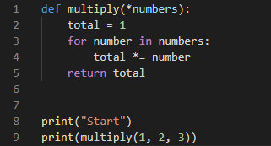
how to find and fix bugs in your programs

Slide 3
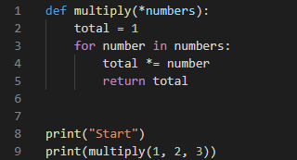

Slide 4
we're going to use a technique called debugging to find and fix this bug

Slide 5
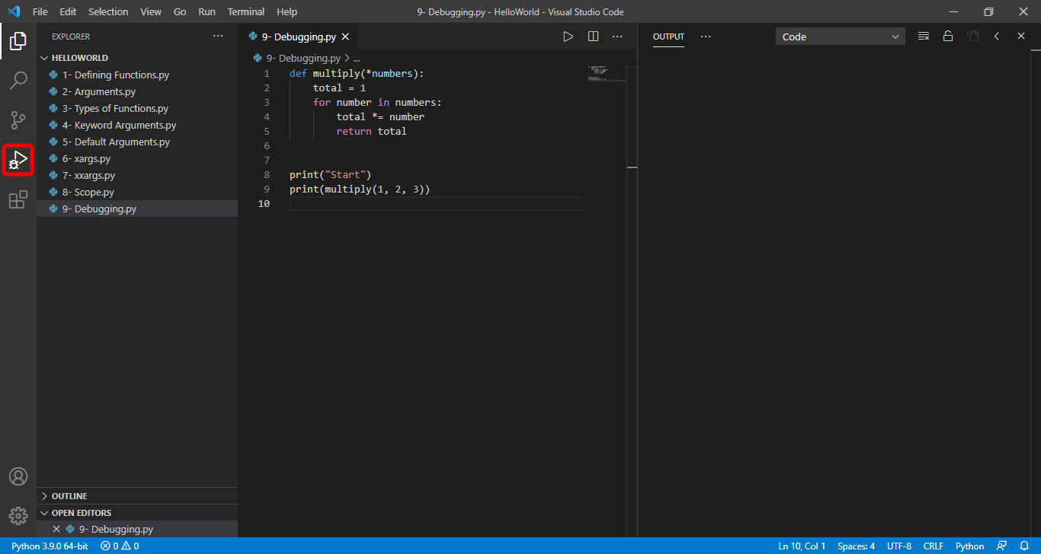
Open the debugging panel

Slide 6
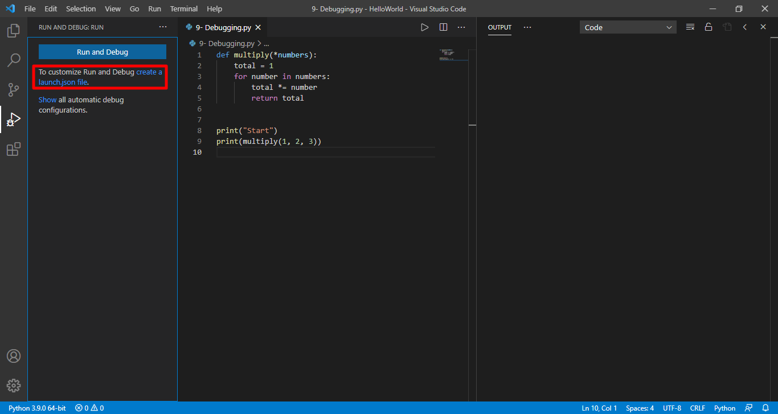
The first time you want to use debugging in the Python project you need to click this:

Slide 7
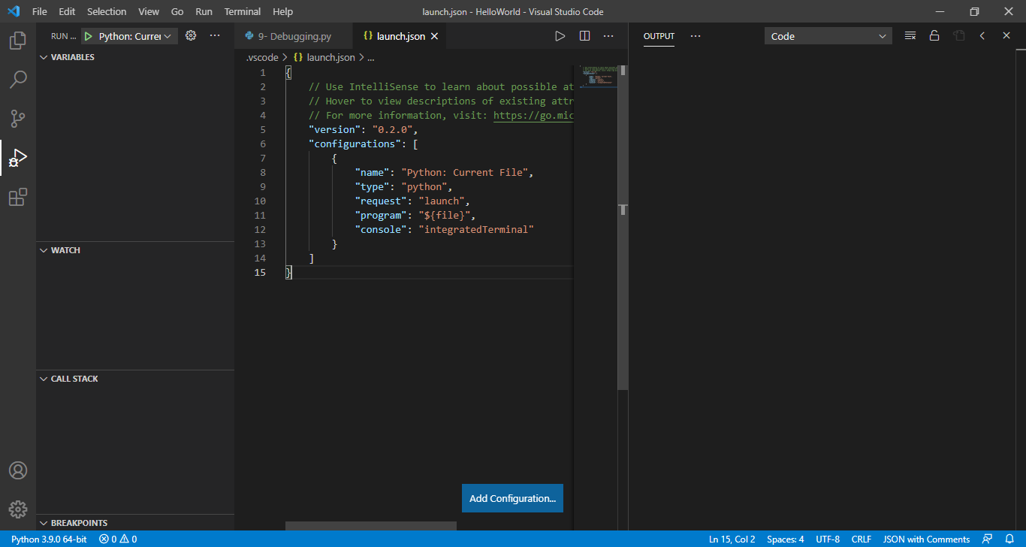
This will generate a new file called launch.json. In this file we have a bunch of debugging configuration. you never have to touch any of this. so don't worry about it. Close it.

Slide 8
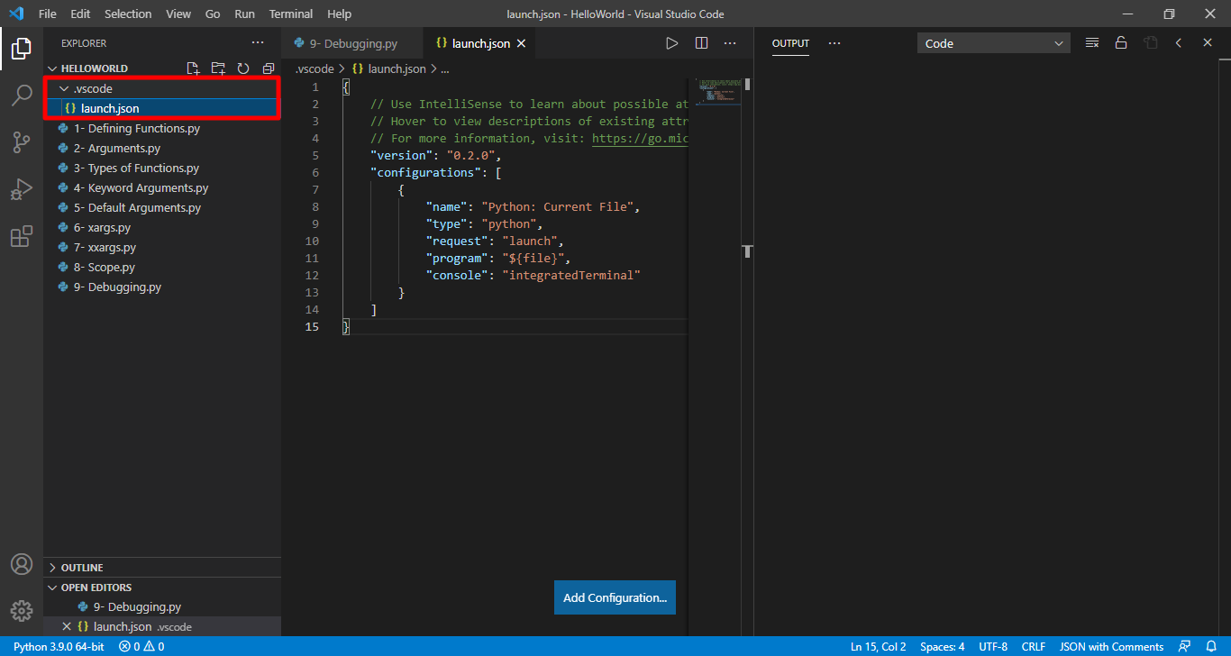
You can see this file is placed inside of this VSCode folder
Now when we have this file we can go to the debugging panel and

Slide 9
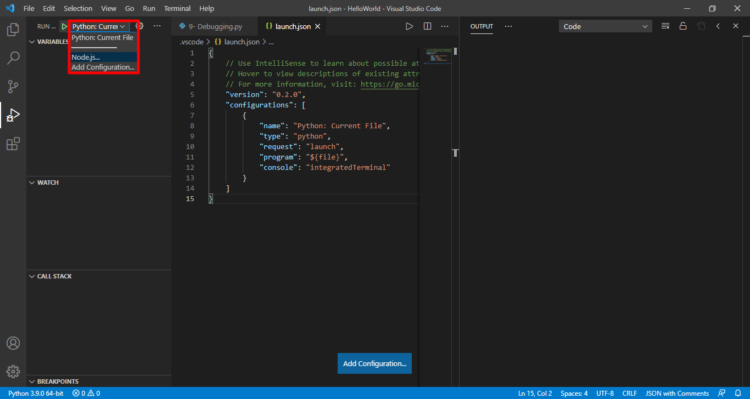
from this list we can select a debugging configuration
Some of these configurations are useful for more complex applications. For example we use Python Django to debug a Web application built with python.

Slide 10
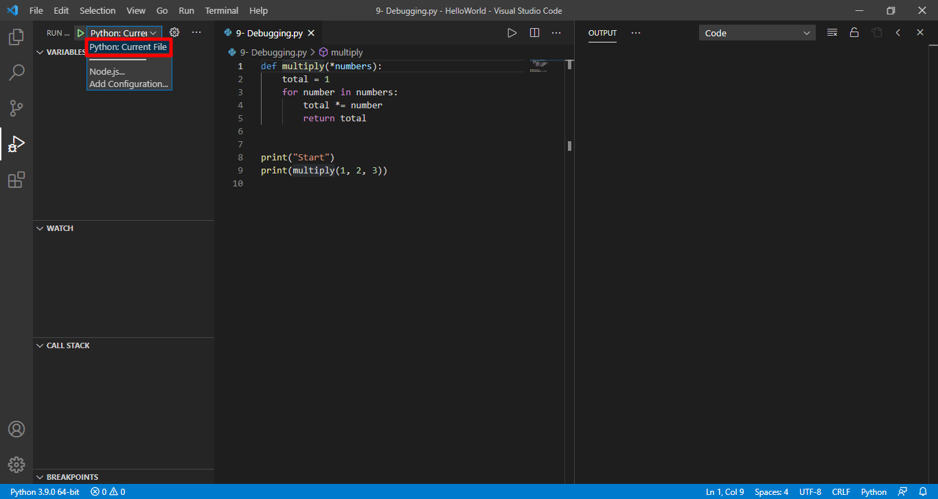

Slide 11
Now to start debugging first we need to add a break point on one of these statements.
put the cursor on line 8 and insert a breakpoint by pressing F9 So this is a break point.
We can press f9 one more time to remove it.
Now we can press F5 to run the application up to this point

Slide 12
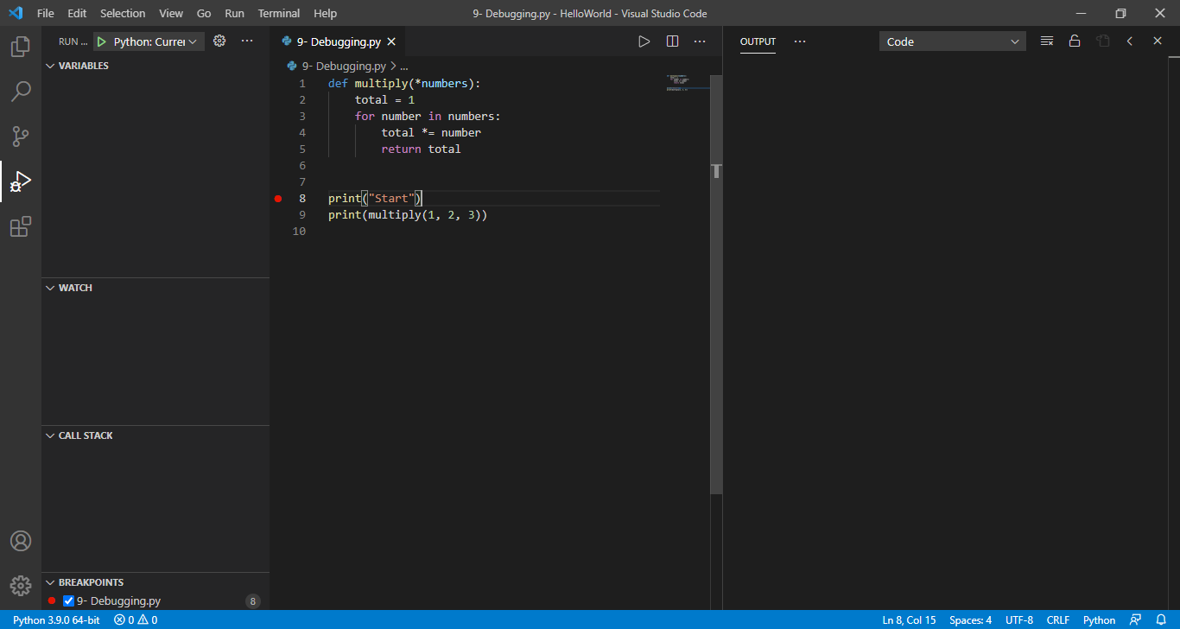

Slide 13
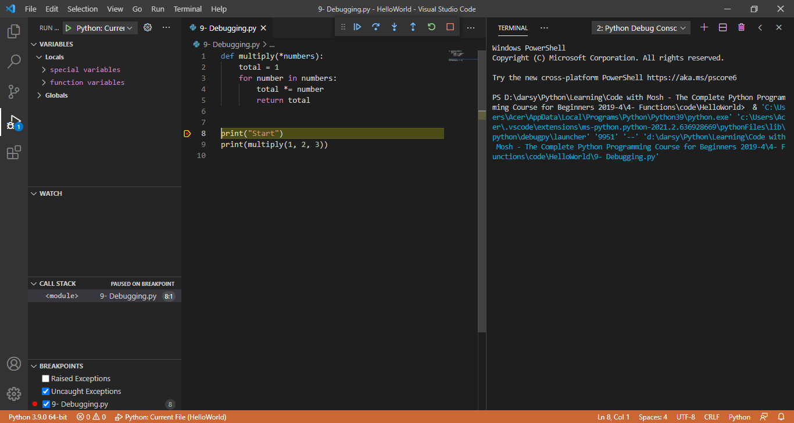

Slide 14
Now we can execute this program line by line and see exactly what happens at granting
to execute one statement at the time Press F 10

Slide 15
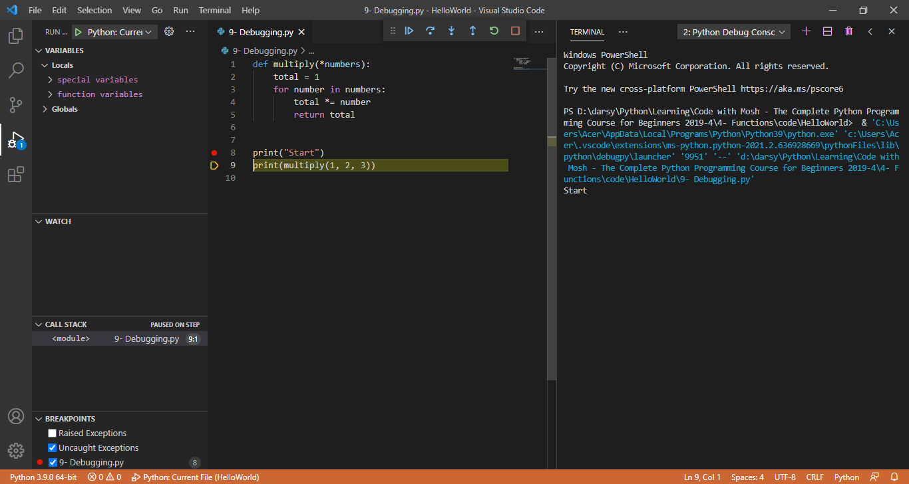
Now we're on line 9. However on line 9 we're calling the multiply Function if you press F10 again the execution stops. so we couldn't figure out why we got one as a result of multiplying these numbers

Slide 16
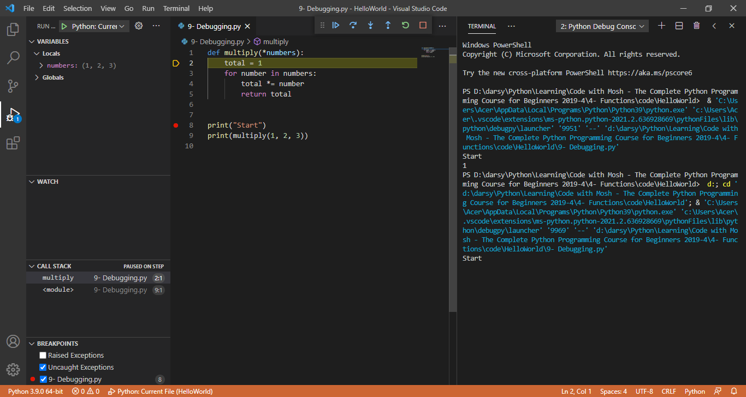
Press F5 again
F10
At this time we want to step into this multiply function so we see exactly what is going on here. F11

Slide 17
So if you're calling a function that you have defind you can step into that function using F11
Now here we are in the multiply function On the left side, inside the variables panel, you can see all the variables that are meaningful in this function
our total variable is not in this list because it's not defined yet
The moment we step over this line with F 10 total comes to existence and you can see initially is set to one

Slide 18
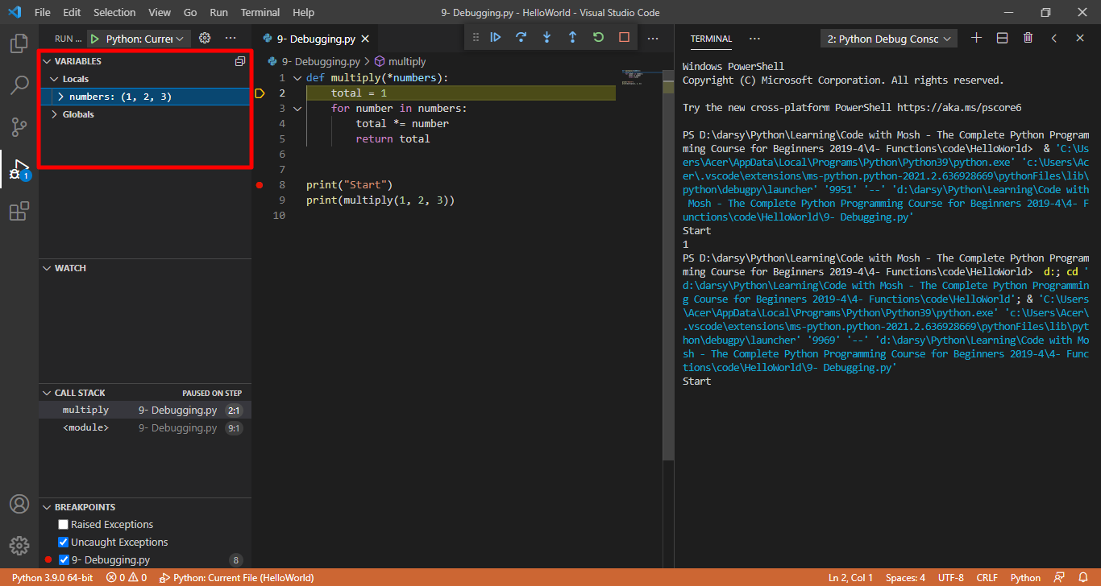

Slide 19
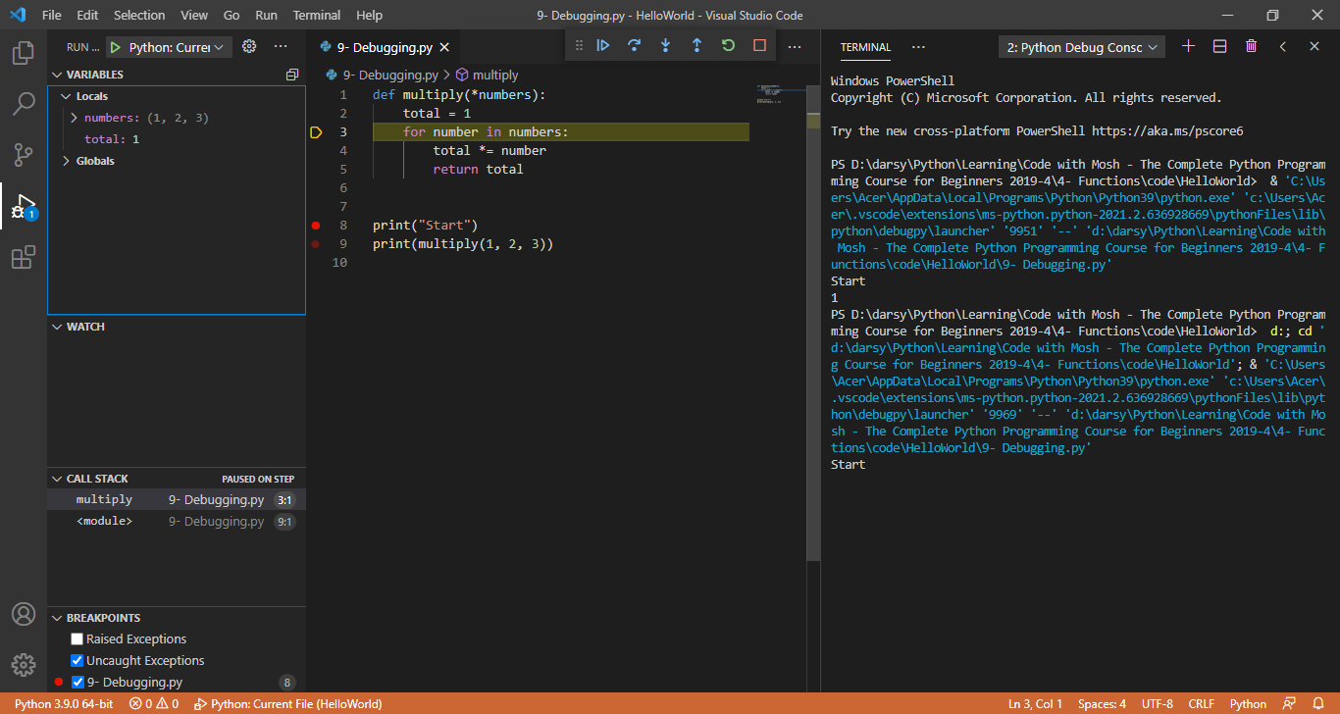

Slide 20
stop the debgger with shift and F5 now

Slide 21
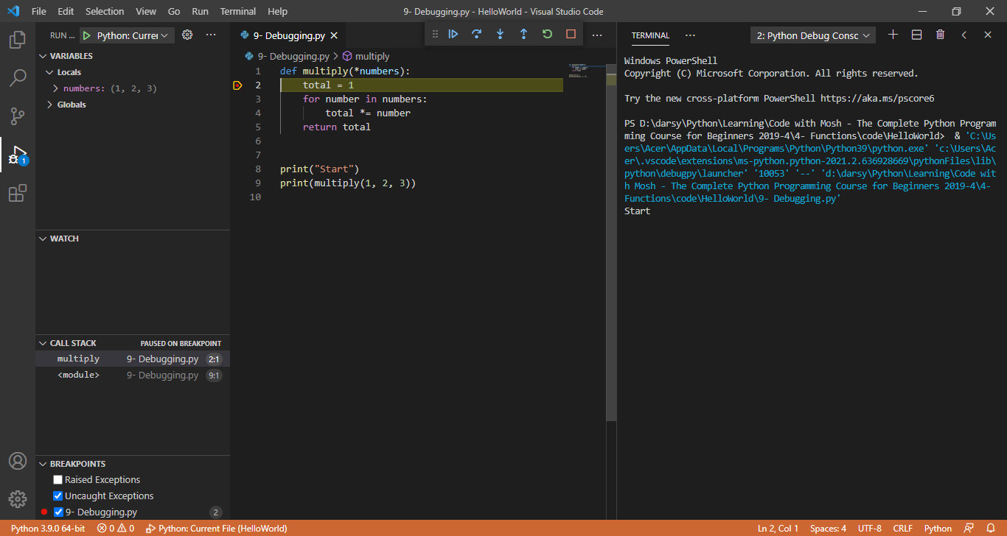
One more tip in this demo. I put the break point on the first line of the program. You don't always have to do this. For example here we know that our multiply function has a bug so instead of putting the breakpoint on line 8 so we could put it on line 2. So when we start the program in debug mode with F5 We immediately start in the multiply function and

Slide 22
If you step into a function and you know that that function works properly you can immediately step out of that function with Shift and F11 to step out of the function

